Slide 1
Economic Performance Analysis of Indian States (2011–2020)
- Analysis based on GSDP, Population growth, inflation, gender, and geographic areas-wise unemployment

Slide 2
Executive Summary
Objective:
Track trends in GDP, inflation, and rural/urban unemployment across Indian states from 2011 to 2020.
Key insights:
Urban unemployment remains consistently higher than rural
GDP shows steady long-term growth despite short-term dips
Inflation is generally stable with a few peak years
Certain states combine high unemployment with moderate GDP, signaling need for stimulus

Slide 3
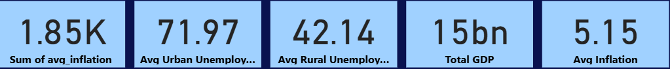
Overall Economic Performance snapshot – key performance indicators
Balanced Economic Indicators: Average inflation remains moderate, suggesting relative price stability.
Urban–Rural Employment Gap: Urban unemployment is noticeably higher than rural, highlighting a need for targeted urban job creation and skill-development programs.
Healthy Economic Output: Total GDP indicates a robust economic foundation, enabling investment in employment and infrastructure.
Inflation Control Success: The difference between total and average inflation suggests seasonal fluctuations are being managed effectively.

Slide 4
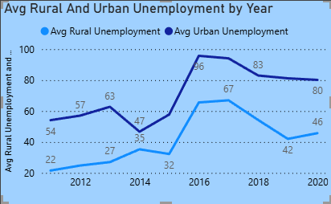
Avg Rural And Urban Unemployment By Years
Balanced Economic Indicators: Average inflation remains moderate, suggesting relative price stability.
Urban–Rural Employment Gap: Urban unemployment is noticeably higher than rural unemployment, highlighting a need for targeted urban job creation and skill development programs.
Healthy Economic Output: Total GDP indicates a robust economic foundation, enabling investment in employment and infrastructure.
Inflation Control Success: The difference between total and average inflation suggests seasonal fluctuations are being managed effectively.

Slide 5
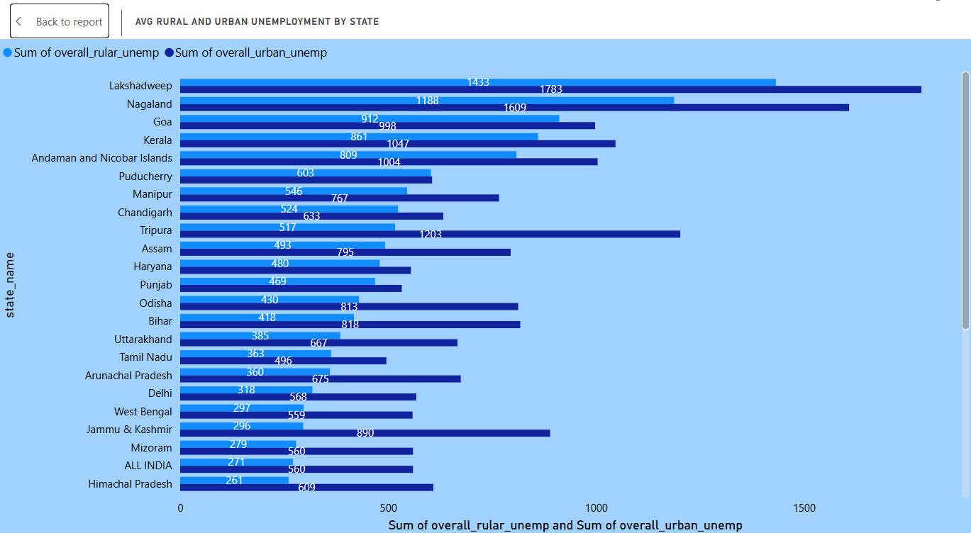
Avg Rural And Urban Unemployment By States
High Unemployment States: Lakshadweep, Nagaland, and Goa have the highest overall unemployment rates.
Southern States: Kerala and Tamil Nadu show lower urban unemployment compared to rural areas.
Urban Unemployment: Delhi and Jammu & Kashmir have notably higher urban unemployment.
National Overview: Unemployment is balanced between rural and urban areas, with some states like Uttarakhand having lower rates.

Slide 6
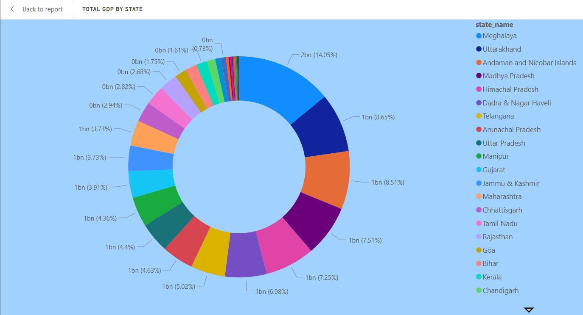
Total GDP By States
Top Contributors: Uttar Pradesh (8.65%) and Maharashtra (7.51%) lead in GDP share.
Strong Performers: Tamil Nadu, Gujarat, and Rajasthan also show strong economic output.
Low Contributors: Meghalaya and Andaman & Nicobar Islands contribute less than 1%.
Stable States: Goa, Kerala, and Chhattisgarh show moderate but steady GDP contributions.

Slide 7
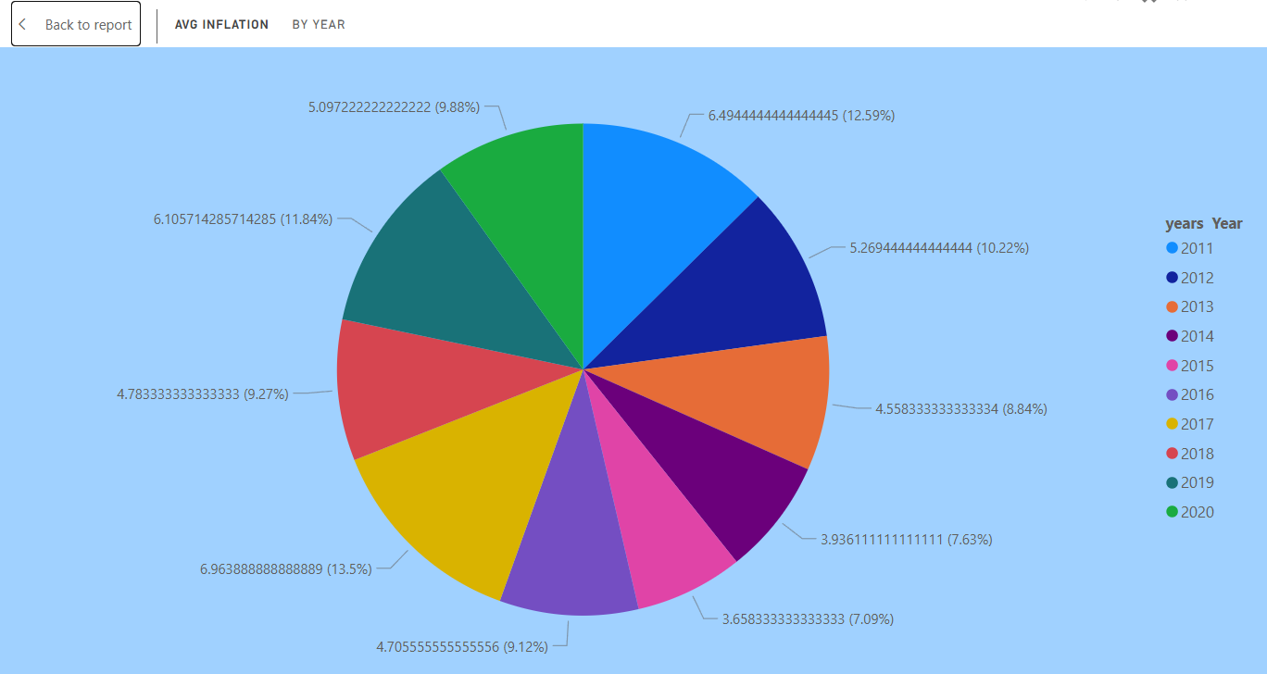
Average Inflation By Years
The highest average inflation was recorded in 2017 (6.96%), followed closely by 2011 (6.49%) and 2019 (6.10%).
The lowest inflation was in 2015 (3.65%), showing a significant dip compared to surrounding years.
Most years fluctuated between 4% and 6%, indicating moderate but persistent inflation.
The trend suggests volatility across the decade, with alternating high and low phases rather than steady growth or decline.
Policymakers and businesses would need to plan for cyclical inflationary pressure, especially in years following sharp declines (e.g., 2015 → 2017 spike).

Slide 8
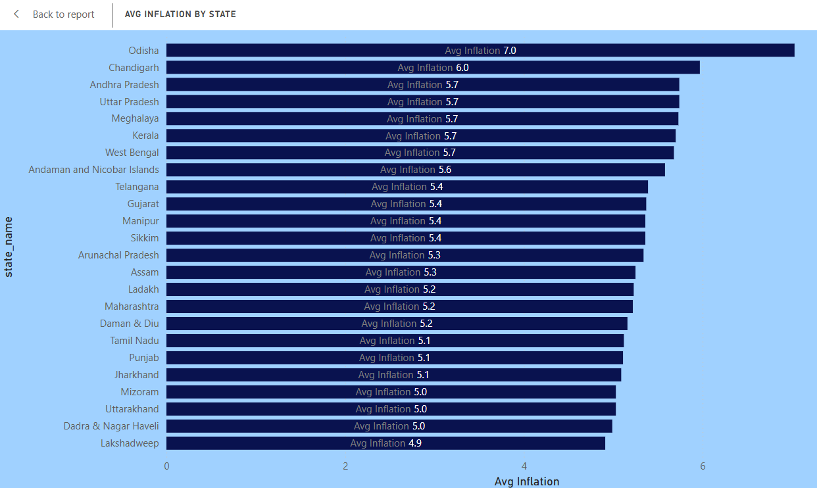
Average Inflation By States
Odisha recorded the highest average inflation (7.0%), standing out significantly from other states.
Chandigarh (6.0%) is the second highest, followed by a cluster of states around 5.7% including Andhra Pradesh, Uttar Pradesh, Meghalaya, Kerala, and West Bengal.
Most states fall between 5.0% and 5.7%, showing a relatively consistent inflation pattern across regions.
Lakshadweep had the lowest average inflation (4.9%), indicating better price stability compared to other regions.
The data highlights regional disparities, with eastern states like Odisha and West Bengal showing higher inflation compared to smaller UTs like Lakshadweep and Dadra & Nagar Haveli.

Slide 9
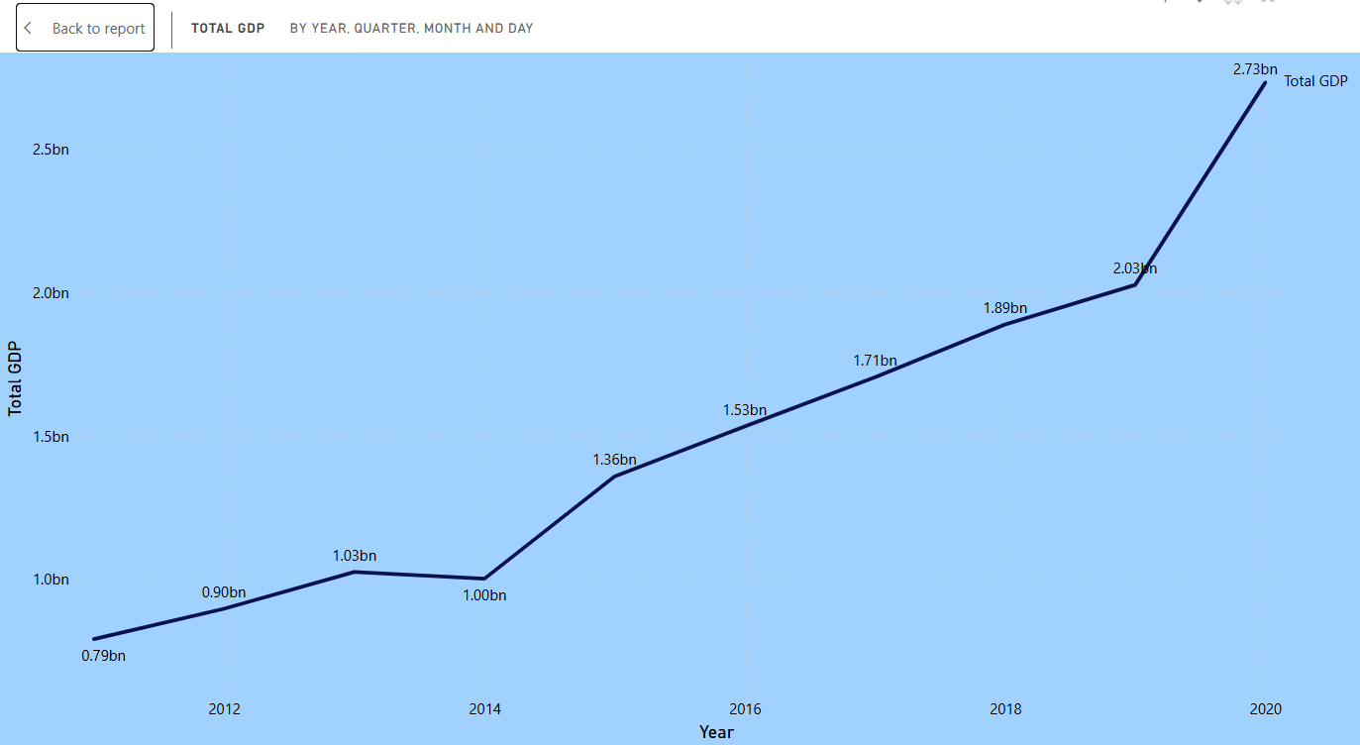
Total GDP By Years
The GDP has shown a steady upward trend from 2011 (0.79bn) to 2020 (2.73bn).
A slight dip occurred in 2014 (1.00bn) after crossing 1.03bn in 2013, but the economy recovered strongly afterward.
The period 2014–2017 marked consistent growth, with GDP rising from 1.00bn to 1.71bn.
From 2017 to 2019, growth remained stable but moderate, moving from 1.71bn to 2.03bn.
The most significant jump came in 2020, when GDP surged to 2.73bn, the highest in the decade.
Overall, the data indicate a long-term growth trajectory, with short-term dips being quickly corrected.

